Slide 1

Ground Water Quality Assessment using Machine Learning Algorithms
By Ashish Bharti, Mukka Koushik, Pratyush R, B Vijesh R. Bhat

Slide 2
Introduction and Problem Statement
Objective -To Develop various machine learning models for multi-class classification problem to classify the ground water quality of different samples across Telangana.The problem also intends to compare various machine learning models performance amongst each other.
Motivation-In Telangana's arid climate, groundwater is crucial for agriculture, domestic supply, and drinking. Traditional water testing is costly and time-consuming. Machine learning offers a cost-effective solution, leveraging readily available data to predict water quality. With complex correlations among parameters, ML models provide efficient tools to identify intricate relationships, ensuring safe water access.
Source-Dataset is retrieved from https://data.telangana.gov.in/dataset/telangana-ground-water-department-pre-monsoon-water-quality-data

Slide 3
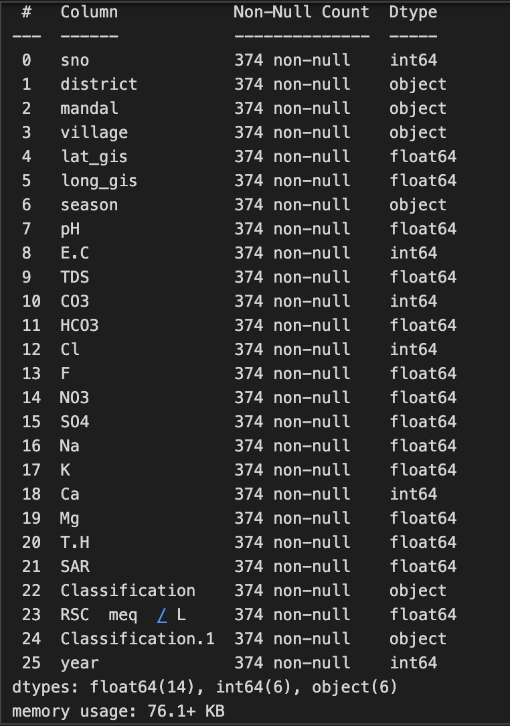
Data Pre-processing
Data Description
Telangana Ground Water analysis data
25 columns: Geographical details, chemical composition, quality metrics
Data Preprocessing
Removed columns with >25% NULL entries
Removed rows with all NULL values
Converted data types (e.g., pH to float)
Combined data from multiple CSV files, standardized column names
Feature Engineering
Label encoding for target column
One-hot encoding for softmax regression
Normalized data by standardizing features
Feature Selection
Removed inessential features for model training
Features/Columns of the dataset

Slide 4
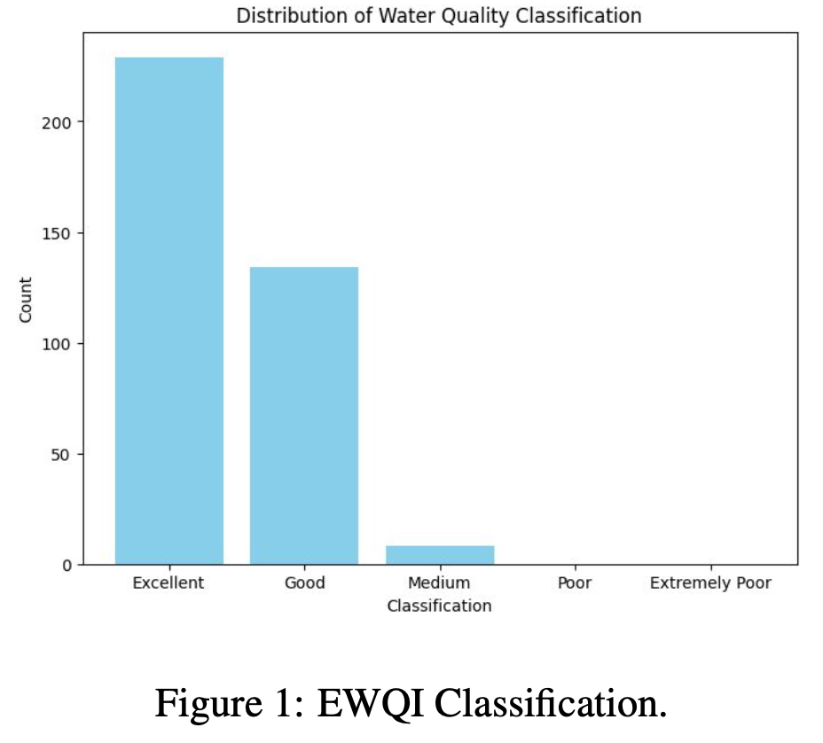
Data Pre-processing (Contd.)
Exploratory Data Analysis (EDA)
Created column-wise distribution plots to analyze data distribution; most columns nearly followed a normal distribution, while some had values in a very narrow range
Constructed a new dataframe with only integer-type columns and normalized all values using min-max scaling
Calculated EWQI (Exploratory Water Quality Index) by assigning different weights to features based on their importance for water potability
Categorized datasets into 5 different classes based on their EWQI values, enabling further analysis based on water quality levels
Plotted the distribution of water quality types for the dataset across Telangana, revealing a predominant C2S1 quality (medium salinity, low sodium content)
Analyzed average chemical concentration vs water quality classes, observing practical trends consistent with the actual composition of Groundwater types
Explored the trend of mean values for different chemicals/features over various seasons and years, uncovering a drastic change during and after 2020 (COVID-19 pandemic year) due to reduced industrial/factory activities

Slide 5
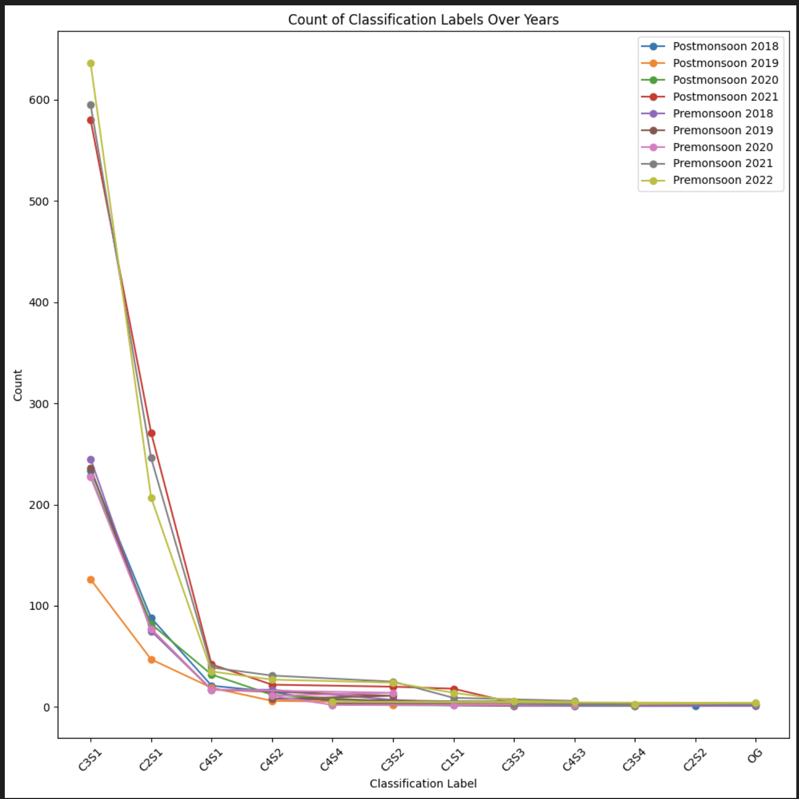
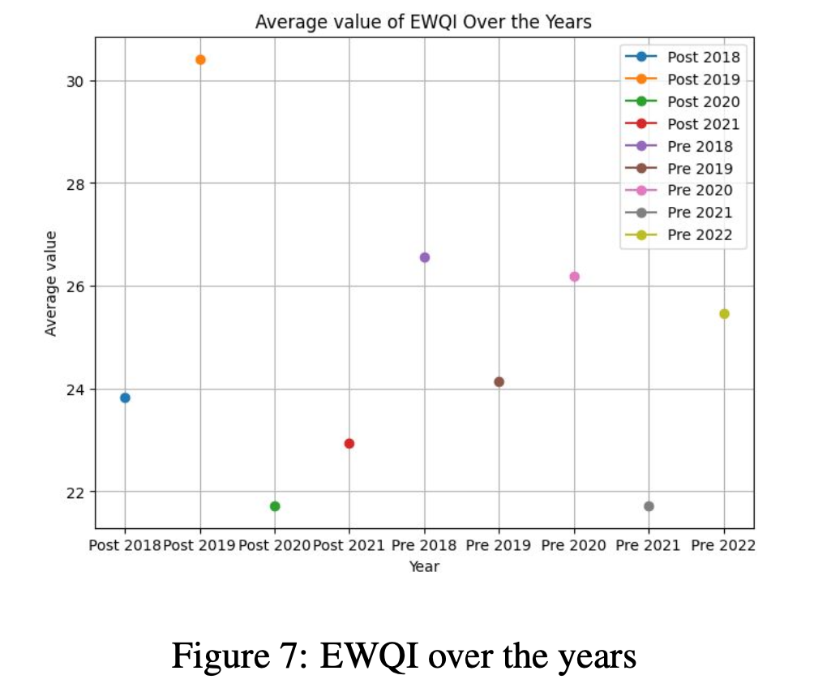
Data Pre-processing (Contd.)
Some Plots for Reference (Explains the data trend across the years)
Fig 1

Slide 6
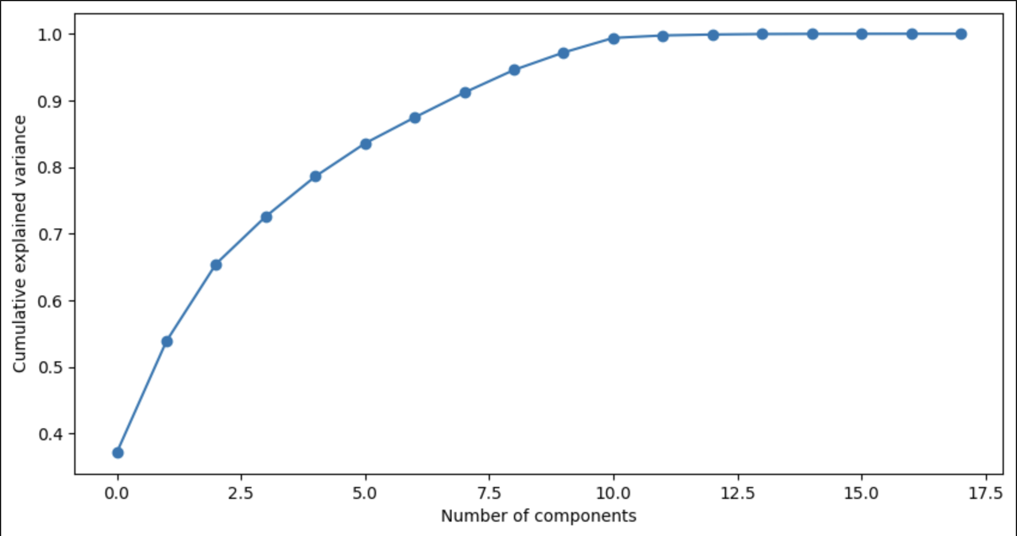
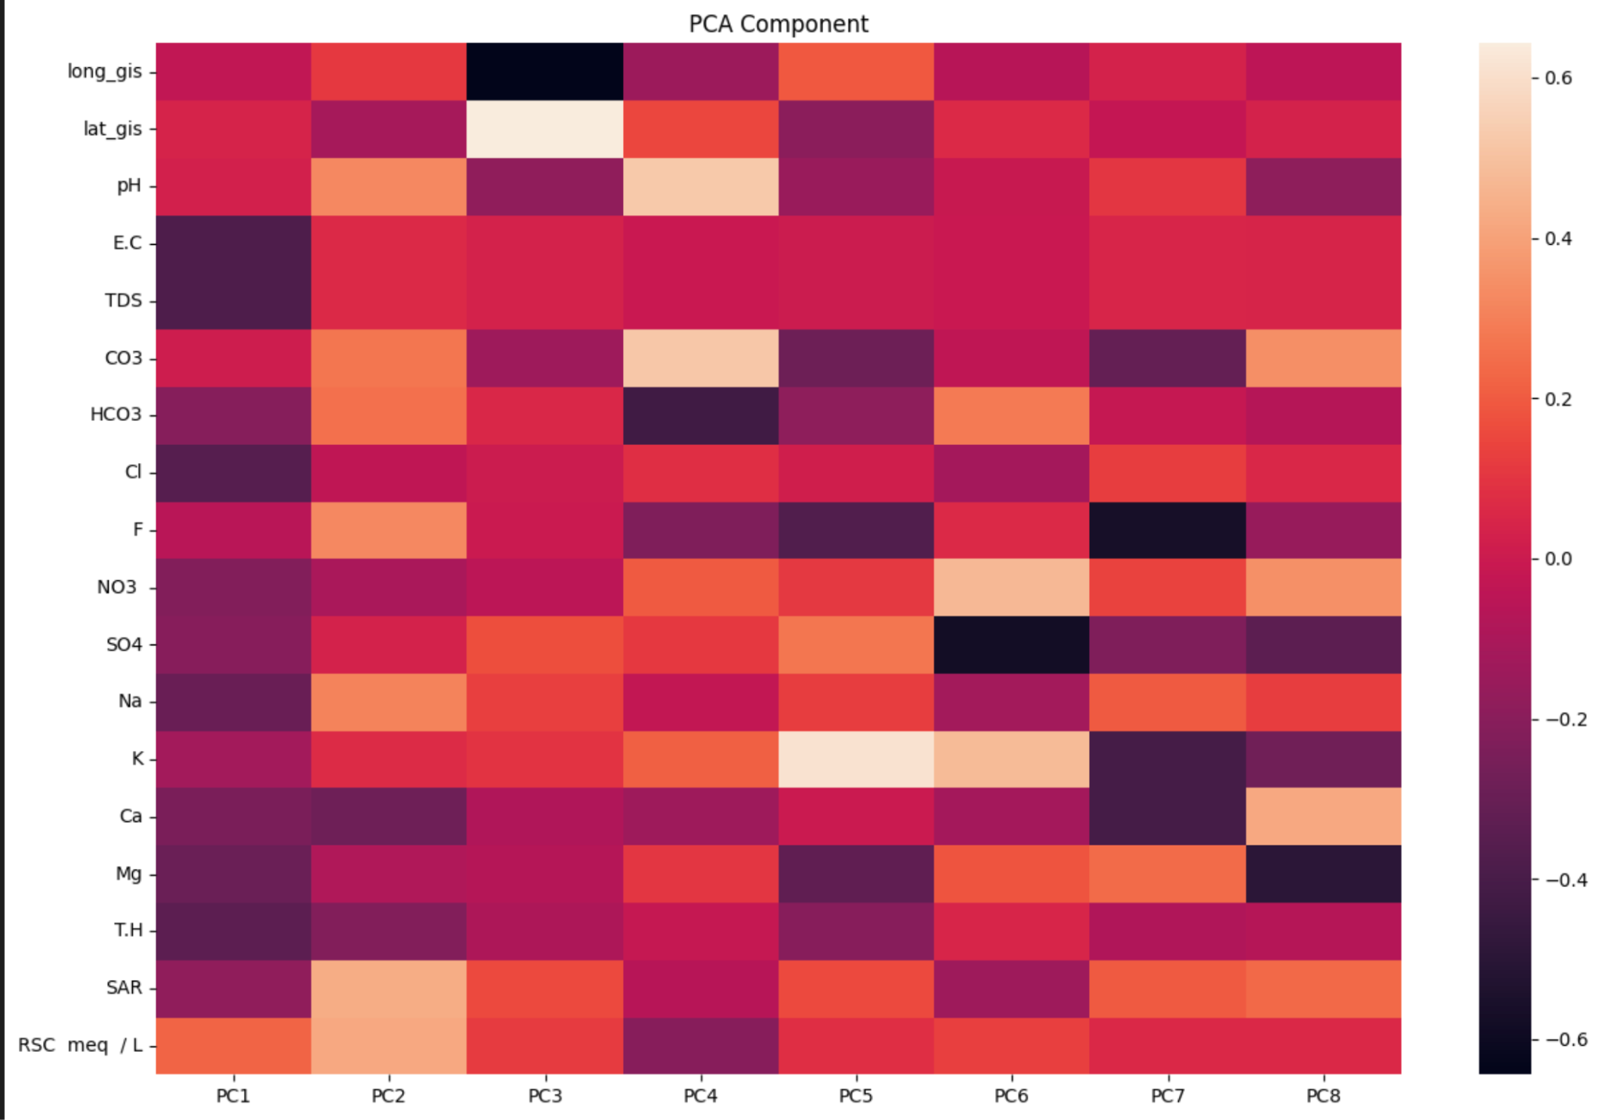
Principal Component Analysis
PCA (Principal Component Analysis) helps in reducing the dataset's dimensionality while preserving most of the variance, leading to computational efficiency during model training and testing.
PCA was applied after EDA and standardizing the data.
Mean value of each feature was calculated, and the covariance matrix was computed for all features.
Eigenvalues and eigenvectors were calculated from the covariance matrix and used to compute the captured variance of each feature.
Explained variance and cumulative variance were computed for all features/principal components.
A variance threshold of 90% was set, and 8 features were selected out of the 25 original features based on this threshold.
Correlation between Principal components and actual features

Slide 7
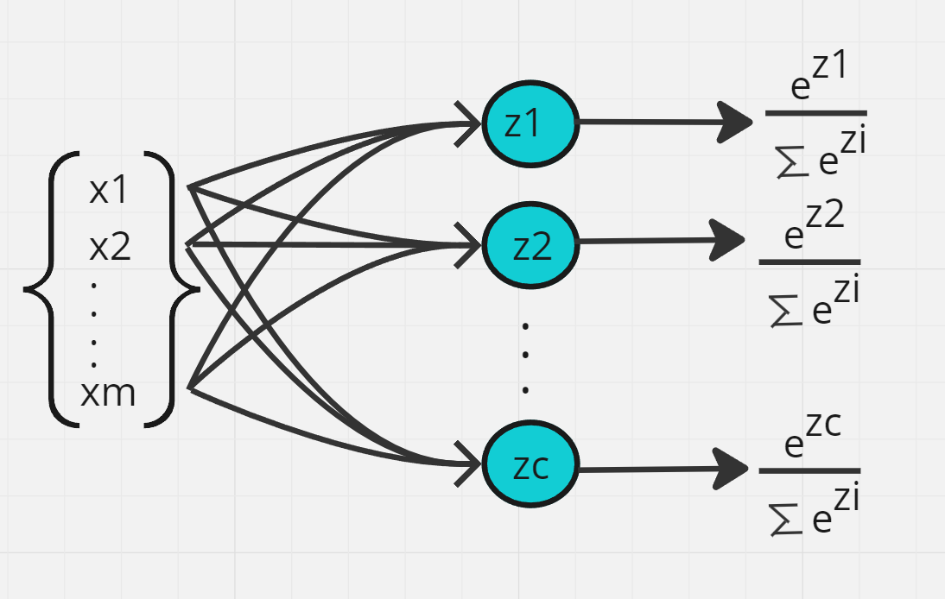
Softmax Regression Model
In softmax regression, the model calculates the probability of each class being the correct classification using the softmax function.
The model’s parameters are learned through gradient descent, where the goal is to minimize the loss function ( cross-entropy was used here ) between the predicted probabilities and the actual labels.
Finally class with highest probability is chosen as the class label of the given sample.
One hot encoding was done for each sample to store the actual label.
The accuracy obtained was 86%.

Slide 8
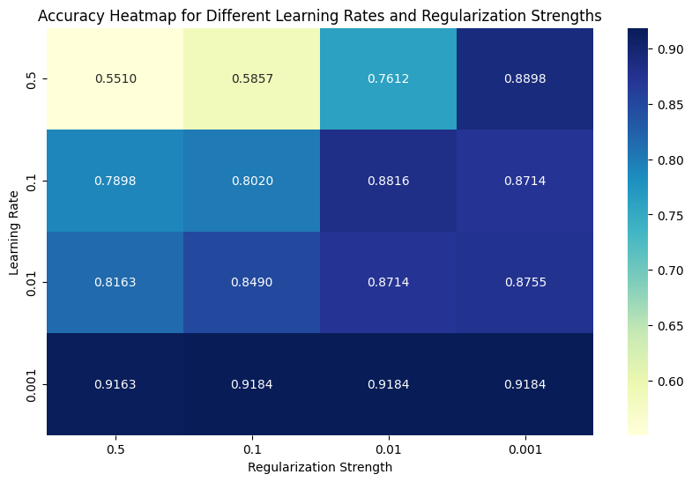
Improvements to Softmax Regression Model
Handling Class Imbalances:gradient descent rule is changed to consider the class imbalances.Updates are multiplied with weights, given in such a way that least count class has more weight and vice-versa.
Ridge Regression:The cost function is added with L2 Norm of weights, so that large weights are penalised.Gradient descent algorithm was used for loss(cross entropy) minimisation.This method is used to prevent overfitting and to tackle bias-variance trade-off.
Hyperparameter Tuning: This is done on two hyperparameters-learning rate and regularisation strength.Grid search method was used on a list of learning rates and regularisation strength.Best accuracy was achieved for learning rate of 0.001 and regularisation strength of 0.01.Train-val-test split used was 0.8,0.1,0.1.

Slide 9
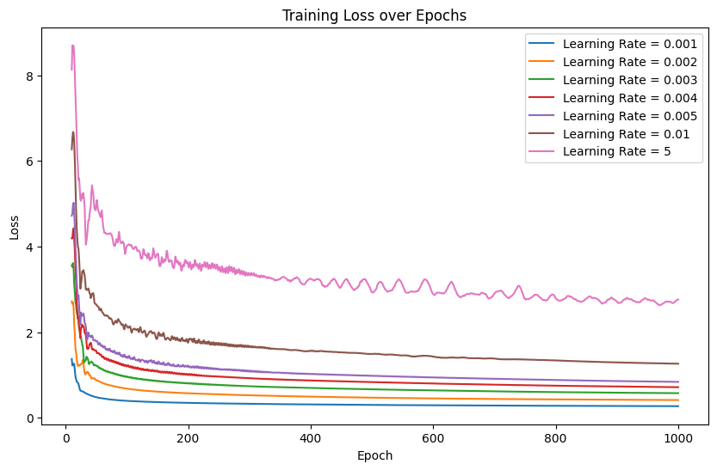
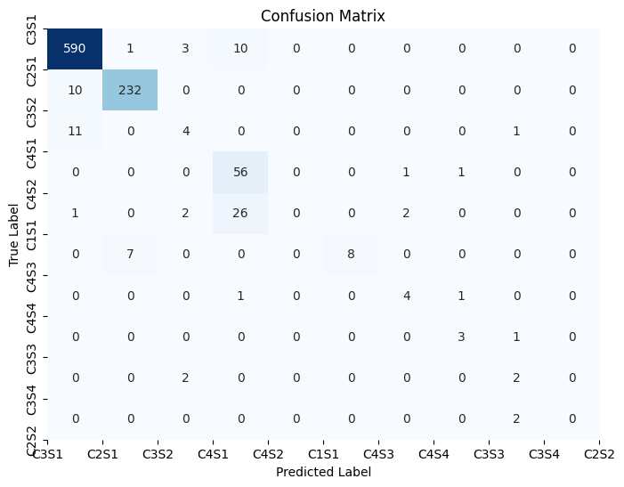
Results of Softmax Regression
After handling class imbalances, test accuracy obtained was 96%.
After Ridge regression and hyperparameter tuning, test accuracy obtained was 96%.

Slide 10
Gaussian Naive Bayes Classifier
This algorithm is based on the assumption that features are independent of each other given the class label.It assumes that features follow gaussian distribution given class label.
Hence, we estimated the parameters of gaussian distribution for each class of each feature, by calculating mean and variance.
Finally, for a given set of features , class with final posterior probability is predicted.
This model gave accuracy of 83%.Low accuracy could be due to the fact that features are considered independent and it was assumed that features follow gaussian distribution.

Slide 11
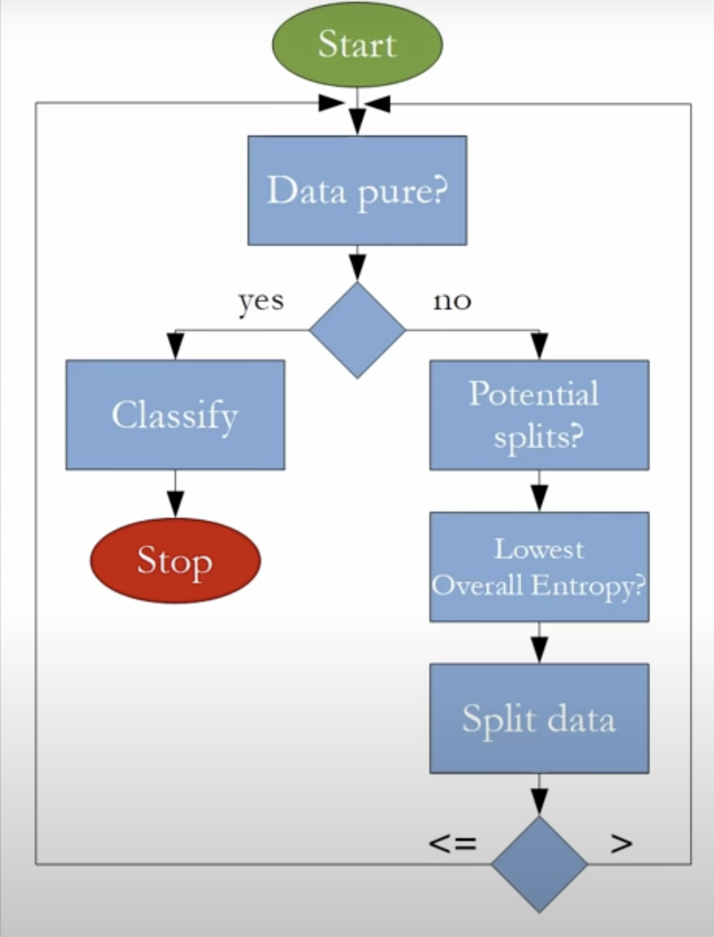
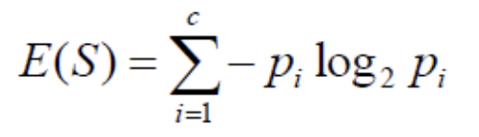
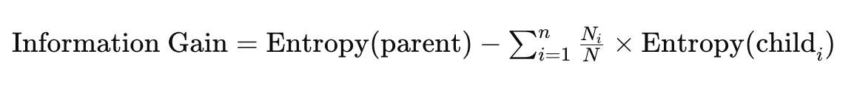
Decision Tree Model
Decision trees is a hierarchical model that splits the data into nodes based on the features. At each node, the algorithm selects the feature that best splits the data, aiming to maximize information gain. Finally (in our implementation) the decision tree predicts the outcome based on majority voting in the node.
Impurity function:
where number of data points in child i : N_{i}
and number of data points in parent: N
The accuracy obtained on the Original Dataset was 94% and on the Reduced dataset obtained from PCA was 88%.

Slide 12
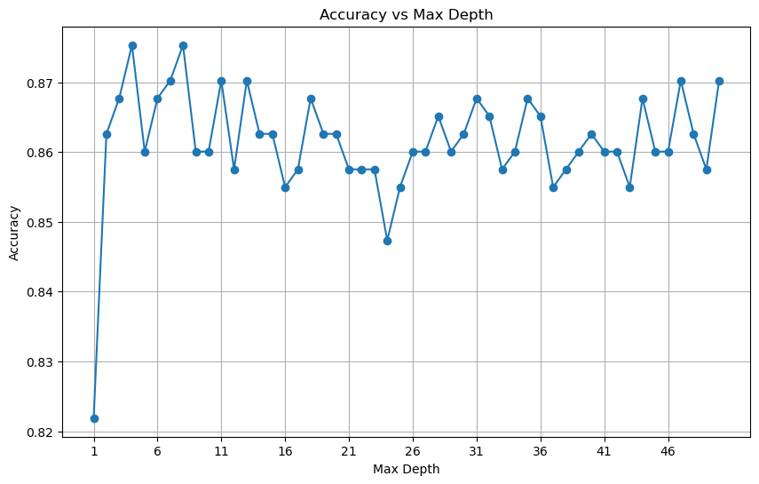
Improvement and Results of DT
Hyperparameter tuning: We have taken two important hyperparameters of a decision tree i.e. its max_depth and the min no. of samples needed to split a node.
Test-Train split: 20-80
Validation-Train split: 10-90
It was found that the tuning of these parameters were not effective in the original dataset. Accuracy: 93%
It was found effective on the reduced dataset obtained from PCA with an accuracy of 90%.
SKLEARN performed poorer on the Original Dataset but was observed to be better on the Reduced dataset obtained from PCA. The results of which will be shown in the last comparison slide.
Fig: Accuracy vs Max-depth plot on Validation Set.

Slide 13
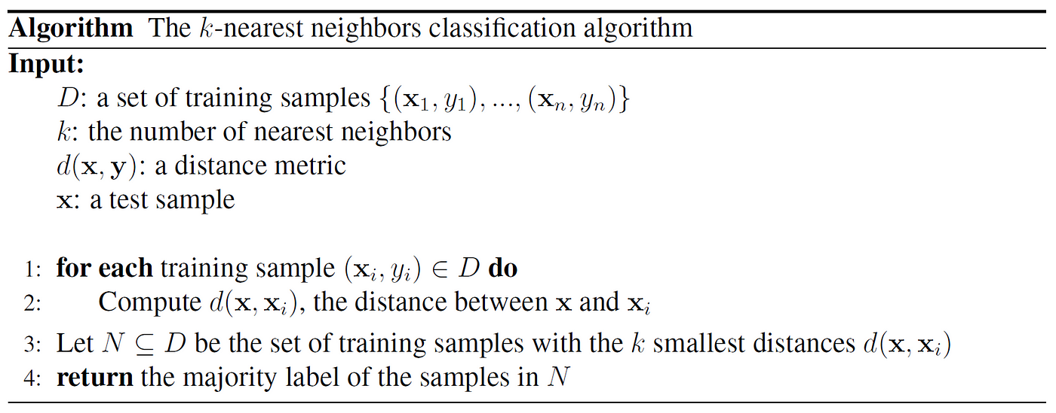
k Nearest Neighbours (kNN) method
kNN is a non-parametric learning algorithm, and has no training phase. Direct classification can be done for a given sample based on given data.
The pseudocode of the implemented code is shown here.
We implemented the pseudocode and used sklearn library for comparison purposes.

Slide 14
k Nearest Neighbours (kNN) method
The accuracies obtained through both routines were comparable on both the original dataset and the dataset obtained after doing PCA for the chosen k.
We used the most commonly used (heuristical) value of k to be the square root of n, where n is the number of samples/data-points. We did not explore the theoretical underpinnings of such a choice, however, the following link reassures us of it: Statistics Stack Exchange, as they present us with concrete references.
We also tried to vary the value of k to get the variation of accuracy results on both the , this can be a form of hyperparameter optimization for this method, though the range of k values selected was limited due to efficiency of the implemented routines. We selected a few extreme values on both end and plotted the accuracies obtained as shown in the plot on next slide.

Slide 15
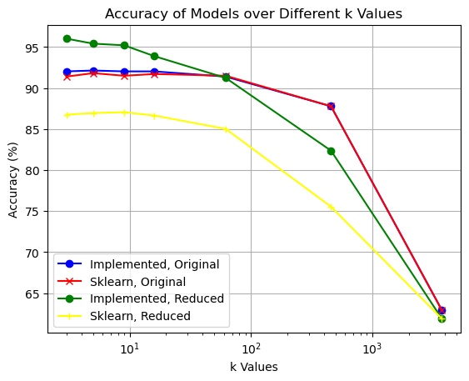
k Nearest Neighbours (kNN) method
Other interpretations from the plot is seen, such as lower accuracy for increase in k, very less gap in accuracy for the original dataset.
We discuss other aspects in report.

Slide 16

Random Forest Classifier
Algorithm Overview
Ensemble of Trees:
Constructs an ensemble of decision trees by fitting the training data.
Each tree node splits based on Information Gain, using GINI impurity.
Leaf node values assigned based on majority class occurrence.
Bagging Technique:
Utilizes bagging to aggregate insights from numerous trees.
Averages out results to enhance robustness.
Performance Evaluation
Comparison:
Random Forest vs. XGBoost vs. sklearn Random Forest (over different number of trees)
Detailed comparison illustrated in accompanying figure.

Slide 17
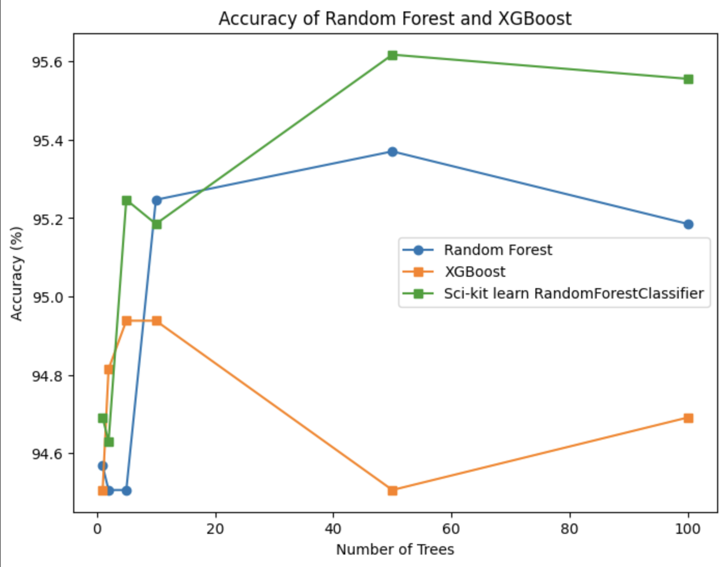
Random Forest Classifier (Contd.)
Hyperparameter Tuning
Decision Tree Class:
Hyperparameters: 'max-depth' and 'max-numbers of features'.
Random Forest Class:
Hyperparameter: 'number of trees'.
Optimal Values:
Max-depth: 7
Max no. of features: 10
Tuned through experimentation on varying tree numbers.
Accuracy Comparison of different random forest models across varying trees

Slide 18
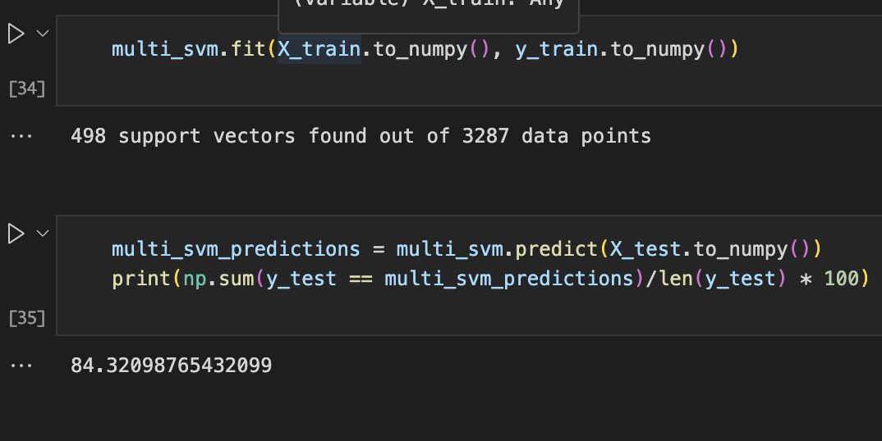
Support Vector Classifier
Multi-class SVM Approach
Creates a hyperplane for each pair of classes (one-vs-one approach)
Total number of hyperplanes: nC2 (n = number of classes)
Classification based on a "voting schema" determined by the maximum value from each hyperplane
Kernel Functions
Implemented different kernel functions: linear, radial basis function (RBF), polynomial, and sigmoid
RBF kernel achieved the best performance (84% accuracy after hyperparameter tuning)
Accuracy of SVC

Slide 19
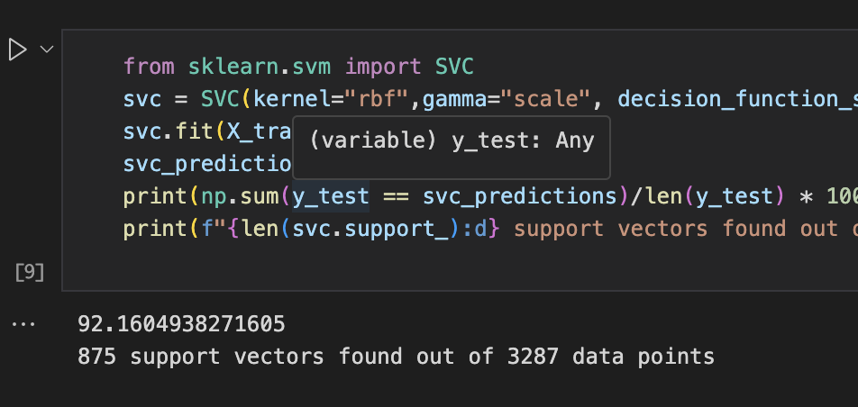
Support Vector Classifier (Contd.)
Hyperparameter Tuning
Tuned hyperparameters for the SVM classifier (SVC)
Gamma (γ): Controls the influence of training data points
C: Regularization parameter for the loss function
Key Points
Multi-class SVM extends the binary SVM to handle multiple classes
Kernel trick allows capturing complex relationships between features
Hyperparameter tuning is crucial for optimizing performance
Achieved 84% accuracy with the RBF kernel after tuning
Accuracy of SVC (SK-Learn Library)

Slide 20
Soft Voting Classifier
This model combines predictions of multiple individual classifiers to make final prediction.
The models we considered to get predictions from are Naive bayes, Softmax, Random forests ( with number of trees=10 ). All predictions for each sample were averaged, which did not result in good accuracy, precision.
Hence, we changed the weightages given to each model’s predictions. The final better weights found for which all metrics are above 0.9 were 0.05,0.85,0.15.
Accuracy, precision obtained were 0.92,9.97 respectively.

Slide 21
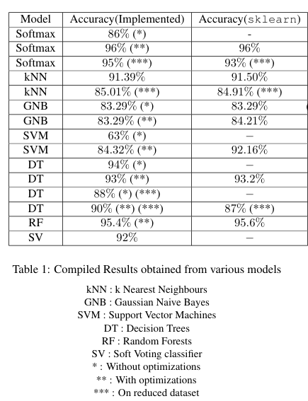
Final Results Comparison
Mean values of features observed during EDA were consistent till post-monsoon 2019 and underwent drastic change from pre-monsoon 2020. The reason for this could be Covid-19.
All the metrics for all models built were compared with sklearns results, the comparisons are shown in the table beside.
It was observed that models, which were trained on pca reduced dataset, also performed well.

